Slide 1



Group 16 – SMM284
Price Prediction

Slide 2
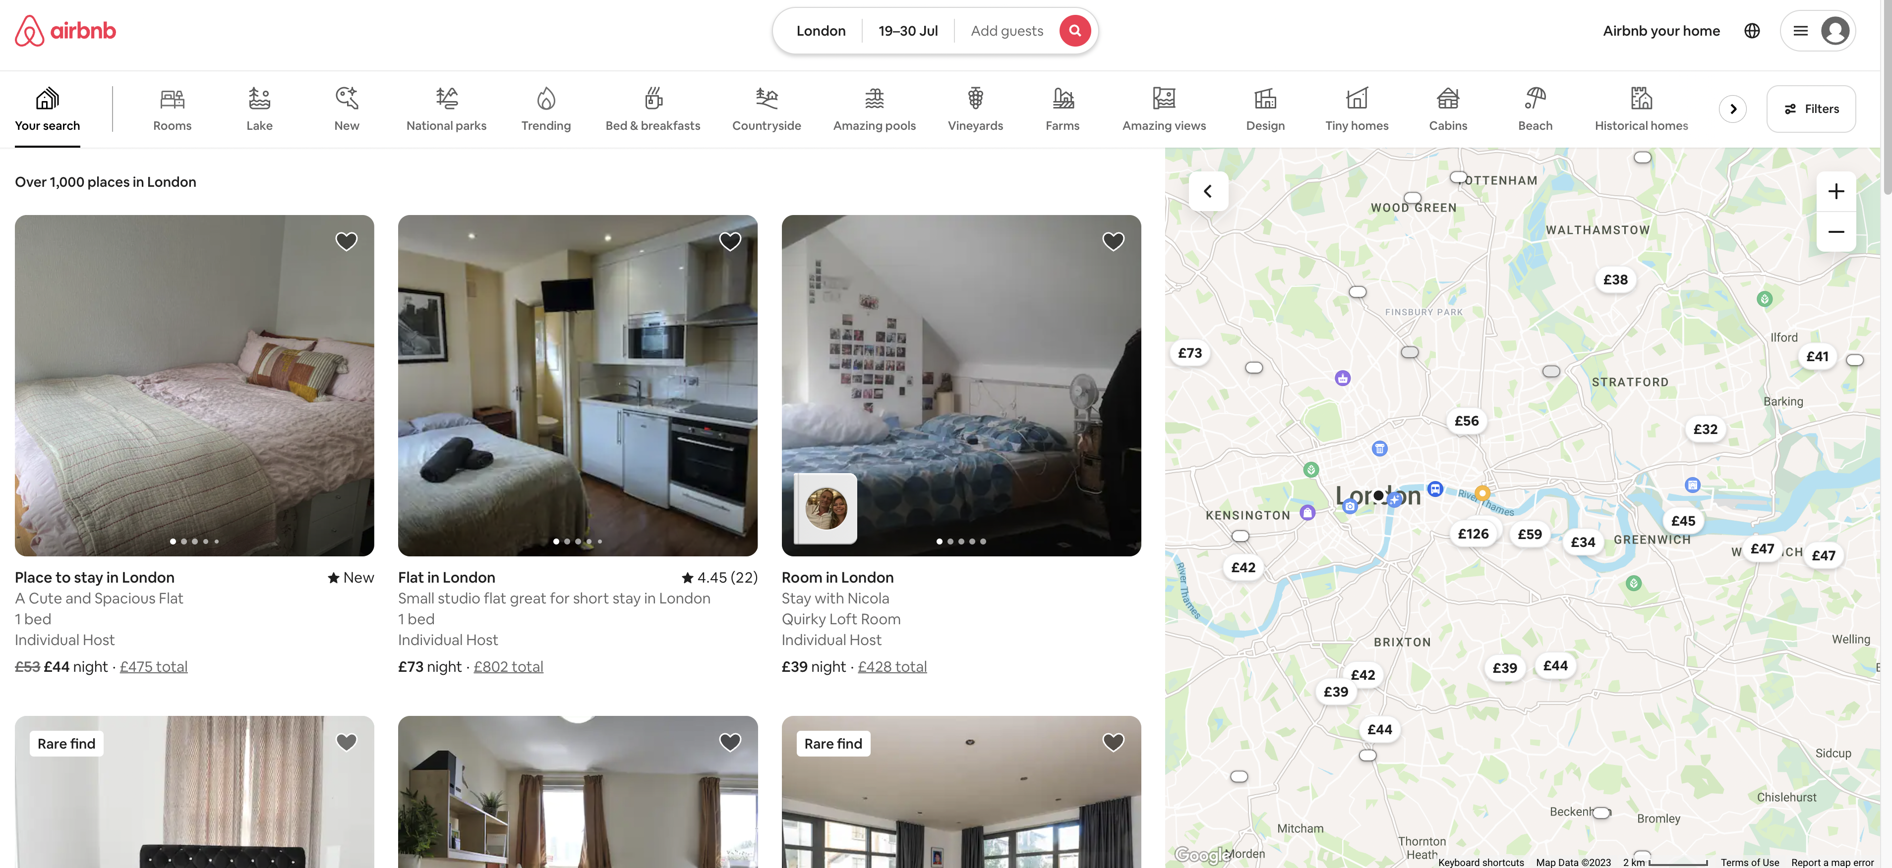
Dataset Introduction

Slide 3
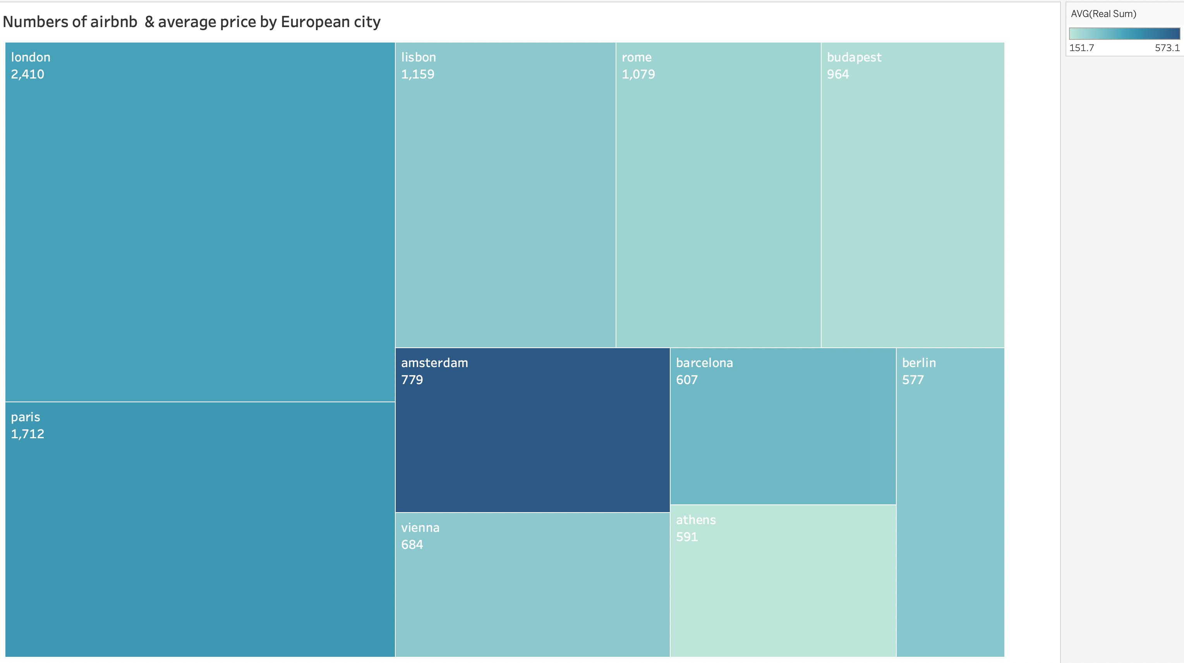
Dataset Introduction

Slide 4
Results Summary
No. | Model | Feature Selection | Log Transformation | MAE | MAPE | MSE | R2 | Interpretability
1 | Baseline - Mean Prediction |  |  | 135.69 | 49.12 | 125969.094 | -0.025 | x
2 | Decision Tree |  |  | 90.01 | 30.92 | 149273.74 | -0.21 | x
3 | Random Forest |  |  | 112.81 | 46.14 | 106529.44 | 0.13 | x
4 | XGBoost 1 |  |  | 79.66 | 27.075 | 84893.21 | 0.3 | x
5 | XGBoost 2 |  | x | 71.57 | 21.83 | 84633.68 | 0.31 | x
6 | XGBoost 3 | x |  | 72.3 | 26.16 | 54884.7 | 0.55 | x
7 | Linear Regression 1 |  | x | 75.55 | 25.71 | 43048.83 | 0.39 | x
8 | Linear Regression 2 |  |  | 95.59 | 39.3 | 46148.32 | 0.35 | x
9 | Linear Regression 3 | x | x | 78.37 | 26.5 | 45218.38 | 0.36 | x
10 | Ridge Regression |  | x | 75.55 | 25.71 | 43056.1 | 0.39 | x
11 | Lasso Regression |  | x | 76.092 | 25.9 | 43352.5 | 0.39 | x
12 | Multilayer Perceptron |  | x | 77.43 | 24.5 | 88837.93 | 0.27
13 | Autoencoder |  | x | 83.03 | 27.56 | 92627.68 | 0.245

Slide 5



XGBoost 3 with Feature Selection is chosen
Addressed the multicollinearity issue while requiring low level of data pre-processing
Moderate Interpretability with feature importance
Strong performance

Slide 6
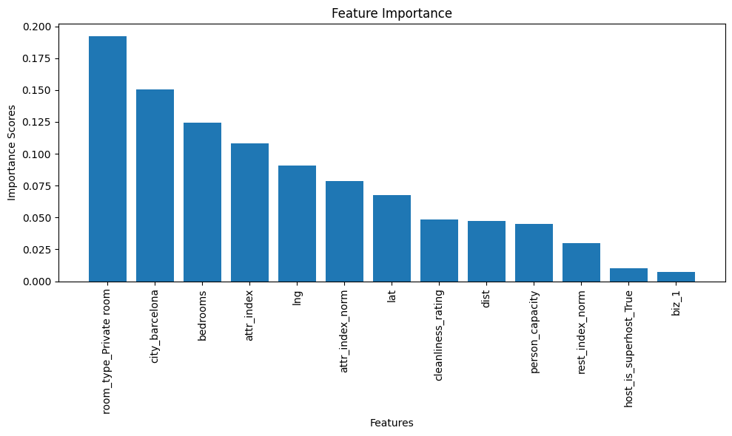
XGBoost with Feature Selection – Feature Importance

Slide 7
Business insights & applications
PRICING OPTIMIZATION
Owners can adjust their pricing strategy based on identified significant features, such as the number of bedrooms, location coordinates, and other relevant attributes.
PEAK SEASONS IDENTIFICATION
Owners can offer higher rates during peak seasons when demand is high and adjust prices accordingly during low-demand periods to maintain a steady flow of guests. This approach can lead to improved financial performance and better utilization of their rental properties.
PROPERTY LISTINGS IMPROVEMENT
By understanding the features that have a significant impact on prices, owners can focus on improving those aspects of their accommodations. For example, they can invest in upgrading bedrooms, adding amenities, or highlighting proximity to attractions or popular landmarks.
PROPERTY INVESTMENT INSIGHT
Potential Airbnb owners can identify locations and property characteristics that align with the features driving higher prices, which can guide their investment decisions and maximize their return on investment.

Slide 8
Recommendations Further information to be collected to improve the analysis
NUMBER OF REVIEWS
PROPERTY DESCRIPTION
This can show the attraction of a place and how customers like/dislike a place
List of what the places offer, house rules, safety, cancellation policy, etc.
RATINGS
DETAILS OF REVIEWS
A measure for the quality of a place. This should be analyzed together with the number of reviews for accuracy.
This can be useful to identify which factors customers care about, their feeling, etc.
PRICING STRUCTURE
NUMBER OF BOOKINGS PER MONTH
Detailed pricing strategy of a property which includes price per room, cleaning fee, discount, etc.
Popularity & estimated revenue of a place.

Slide 9
Thank you for listening! Q&A

